Slide 1

FRENCH
BOOK ERASMUS

Slide 2
1. OUR SCHOOL
Our catholic school called Sainte Thérèse which was a former convent is a private school located in the city centre of Clermont Ferrand .
Our 4 different buildings ( nursery school, primary school, middle school and high school) are close from each other in a beautiful green environment with different playgrounds for each level.

Slide 3
We have 6 nursery classes from 3 to 6 years old, and 10 classes from 6 to 11 years old .
There are 403 pupils in our school for 21 teachers.
Pupils go to school 4 days a week (Monday, Tuesday, Thursday and Friday) from 8:30 to 4:30.

Slide 4
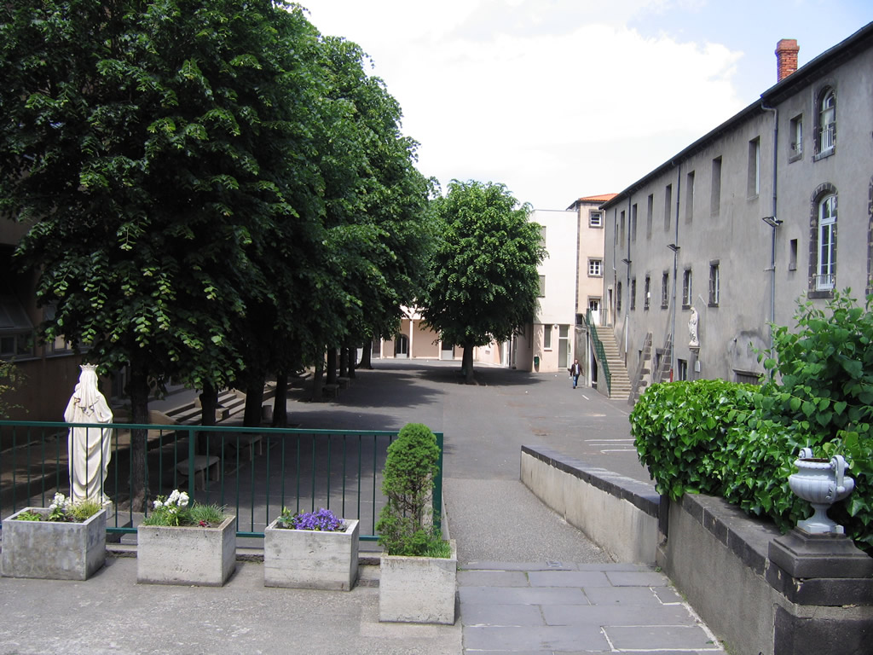
PRIMARY
SCHOOL

Slide 5
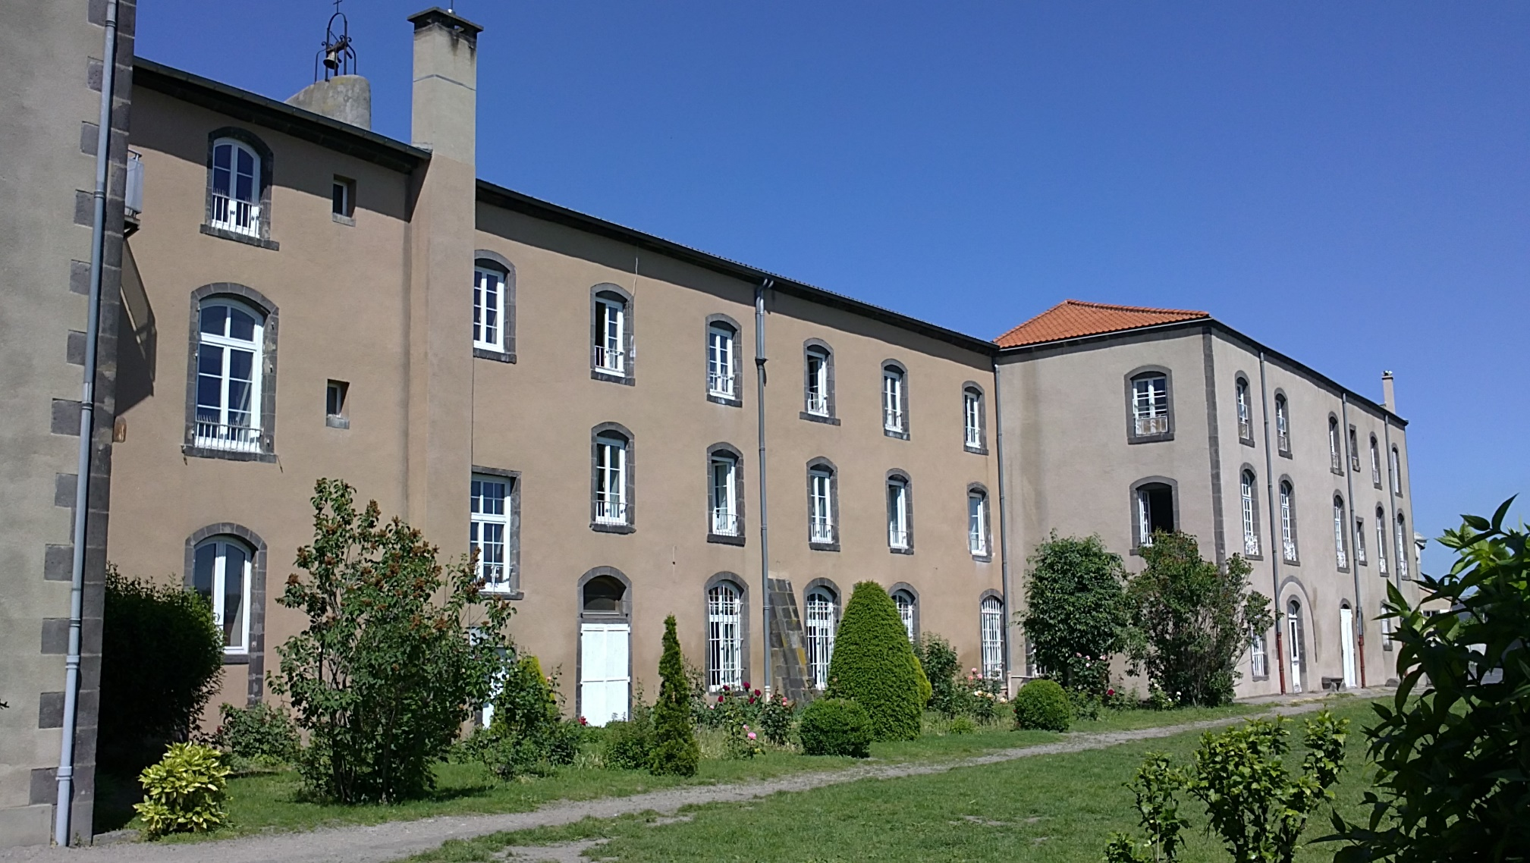

Slide 6
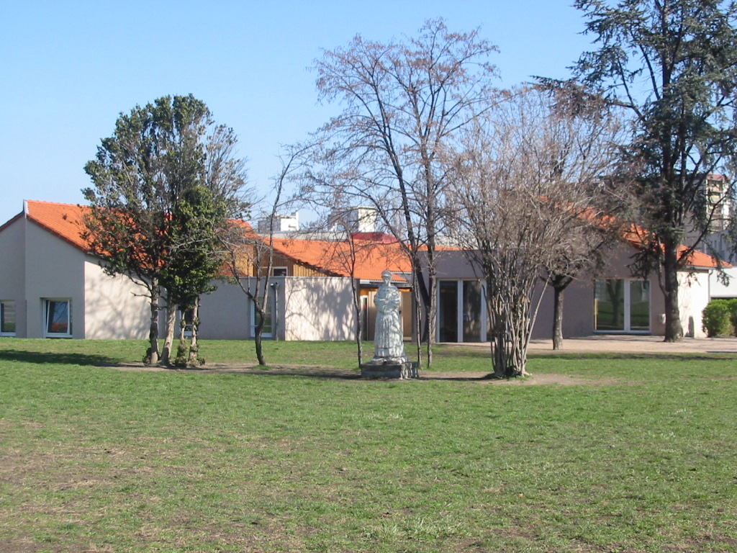
NURSERY
SCHOOL

Slide 7
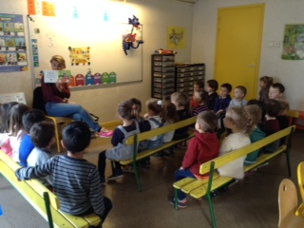
NURSERY
SCHOOL

Slide 8
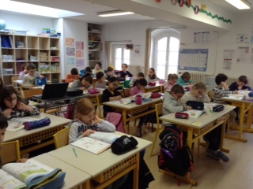
PRIMARY
SCHOOL

Slide 9
Pupils have 2 hours break for lunch that’s why 50% children go back home for lunch time .

Slide 10
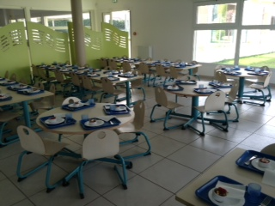
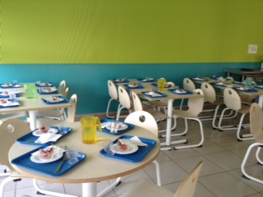
SELF

Slide 11
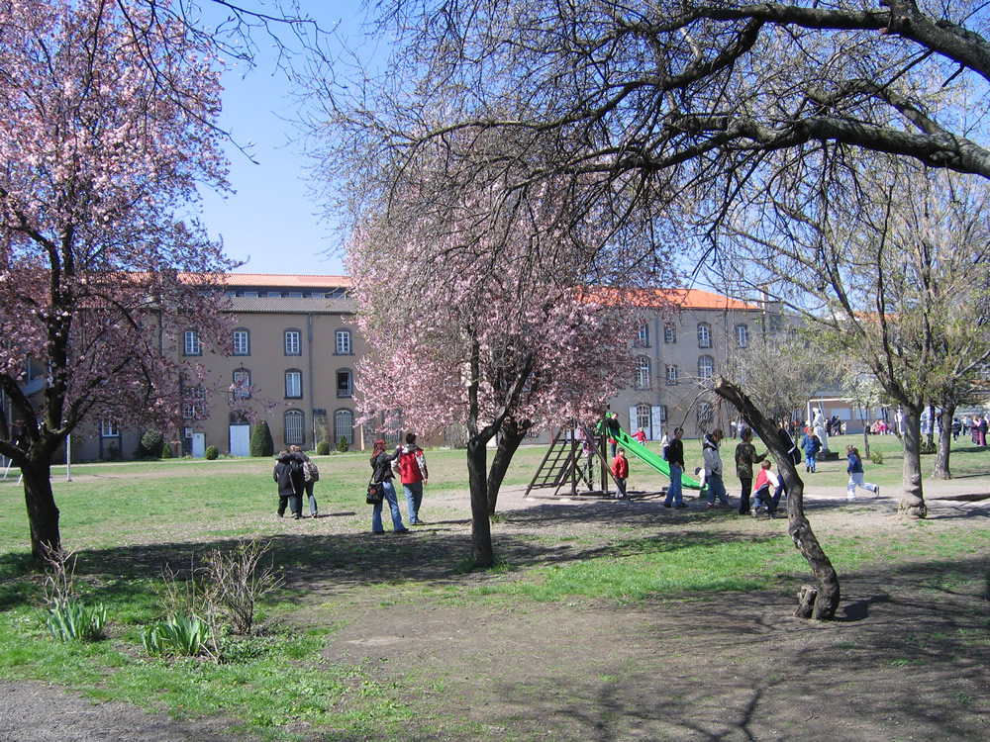
GAMES ON THE PLAYGROUND

Slide 12
Each class has just one teacher who teaches all different subjects ( French, Maths, History, Sciences, Arts , ) except English , Sports and Music.
Nearly all our teachers work full part in our school . In kindergarden , teachers receive the help of an assistant so they are 2 in classes .
The special features in our educational institution are that we offer different activities such as circus school , or, we have a partnership with the ASM which is a huge rugby club so, we can bring pupils to their gymnasium and so, take advantage of the structures. We have a specialized and qualified teacher for children who have difficulties in learning. In our school we start to learn English in nursery school once a week : (30 minutes) and in primary school , it is twice a week (45 minutes). Every other year, we organize a school trip in London with pupils aged 11 and 12 .

Slide 13
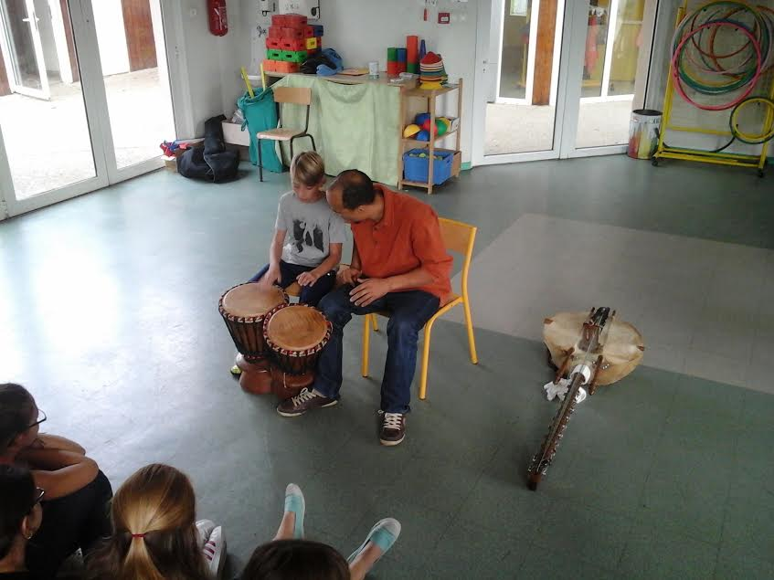
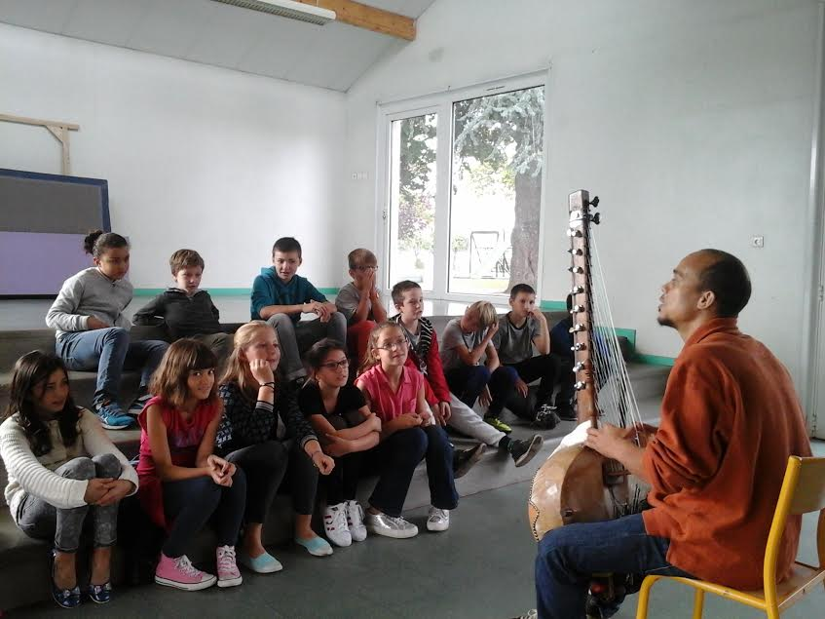
MUSIC

Slide 14
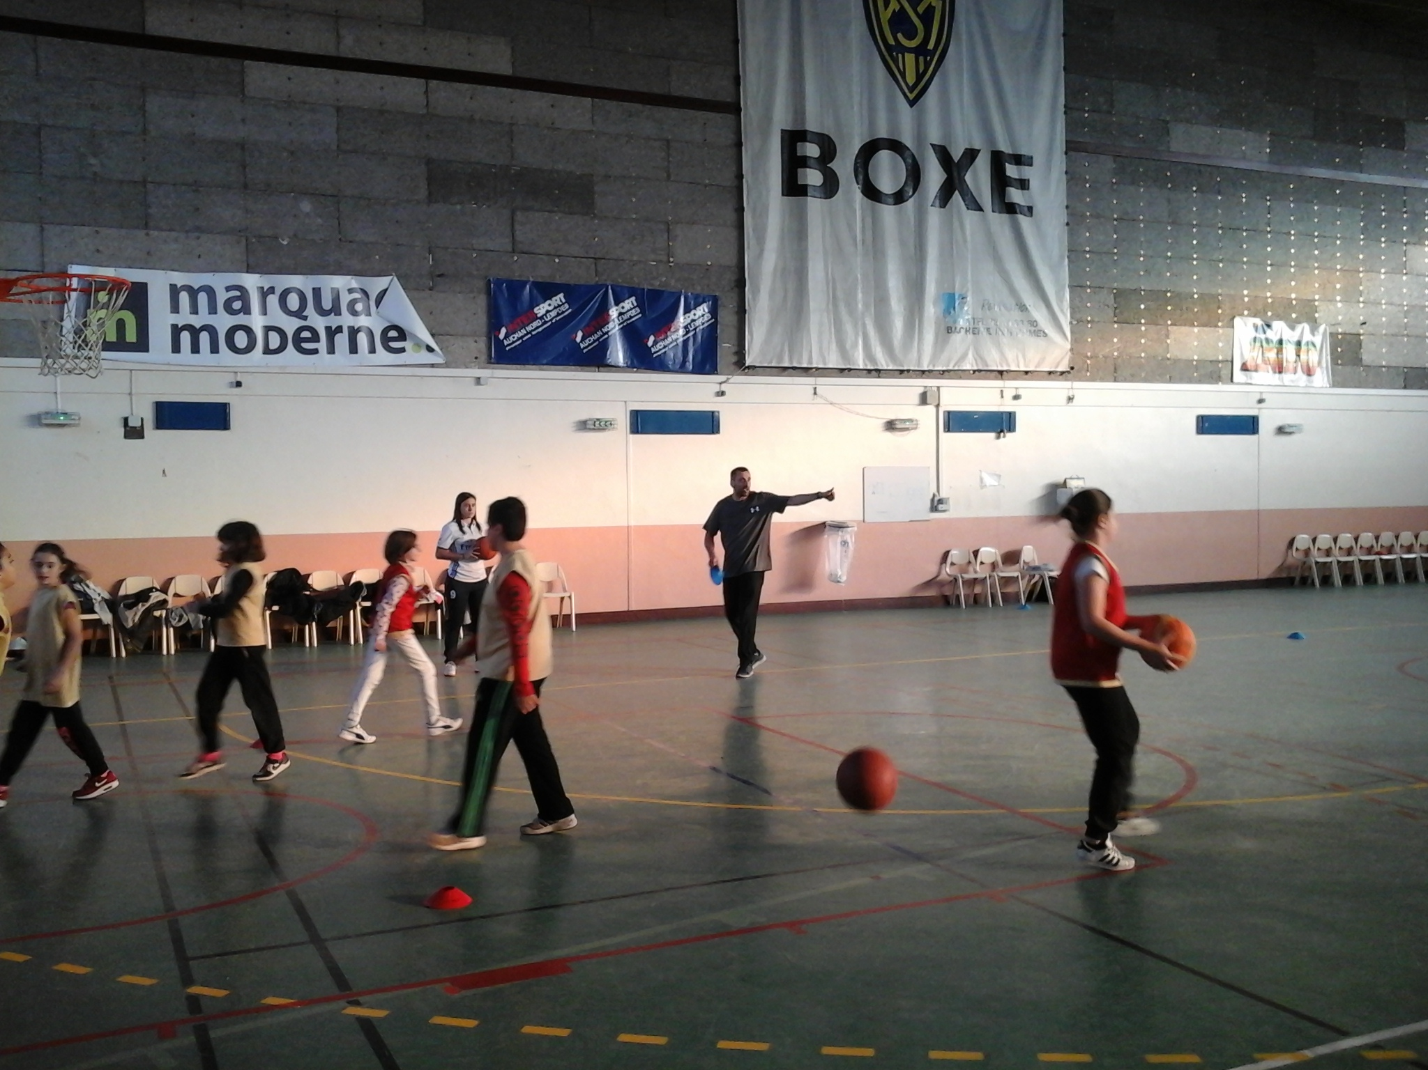
ASM

Slide 15
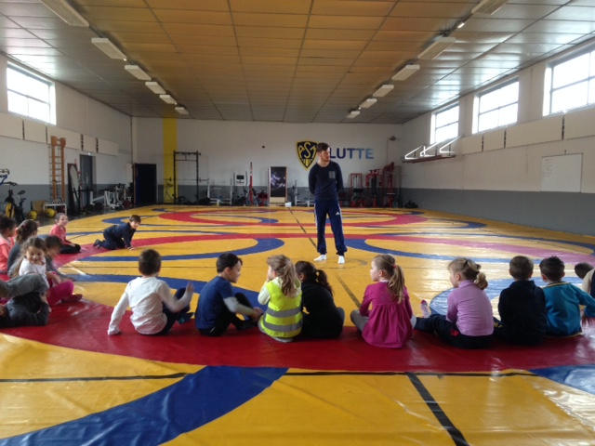
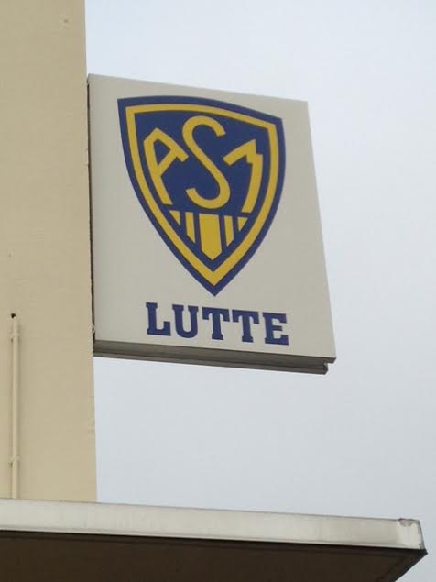
WRESTLING

Slide 16
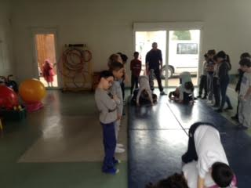
CIRCUS

Slide 17
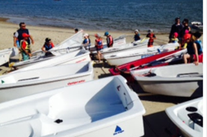
SEA CLASS

Slide 18
2. WORKING WITH LEGO
First , we started to work with playmos the first year of our project but then as soon as we had the lego training in poland ( because it was very difficult to get one in France ) we started to work with legos and we discovered the many possibilities that this tool can offer.
During my English classes I always try to finish my new lesson with Legos . I realize that pupils learn much more when they use legos .
It is a universal tool and both girls and boys enjoy Legos. When we use Legos we are most of the time half class that is to say, about 12 or 13 pupils. We try to give a limited time ( often 5 or 10 minutes for a creation) pupils like it, they think it is exciting .
We use Legos from the nursery to the primary school. Some teachers use them a lot for Maths , geometry but also for French .
In English I use them a lot in primary school as I told before to illustrate my lessons but also in nursery to develop imagination and creativity ( pupils aged 4 / 5 and 6 had to create stickman ´s family based on the book to learn the family vocabulary and adjectives such as small, big, thin ...)

Slide 19
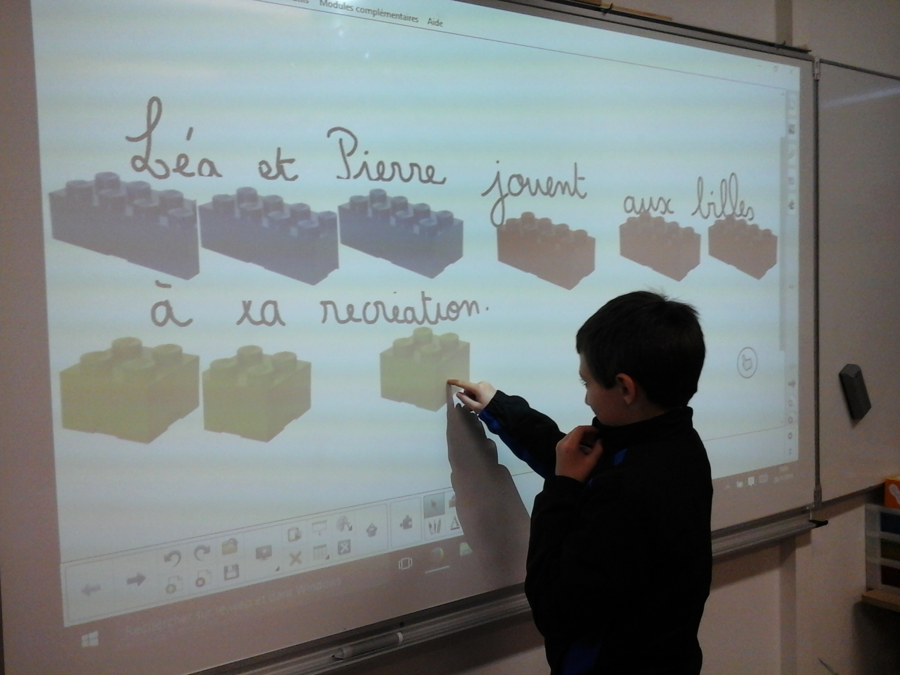
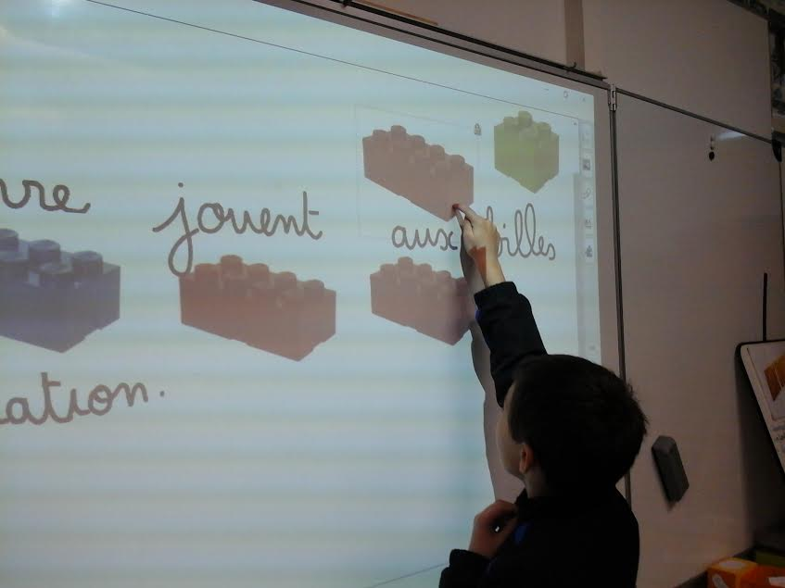
GRAMMAR WITH LEGOS

Slide 20
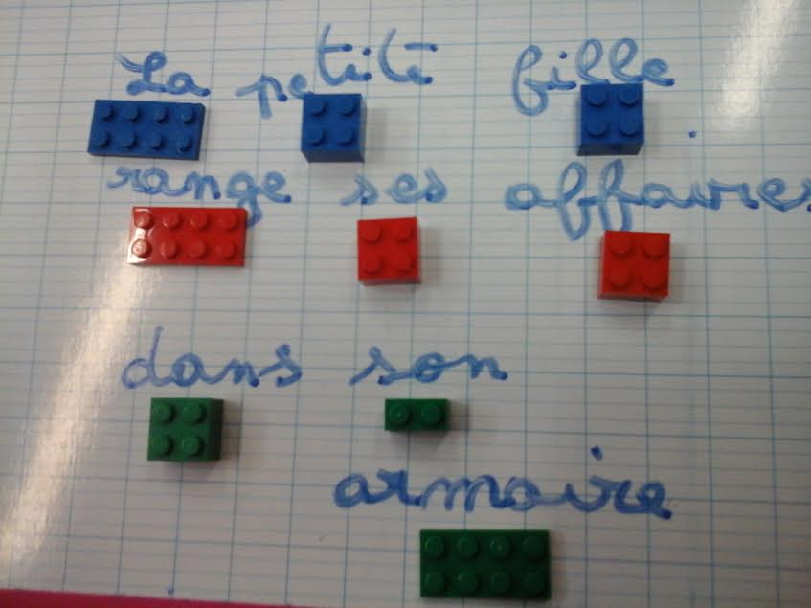
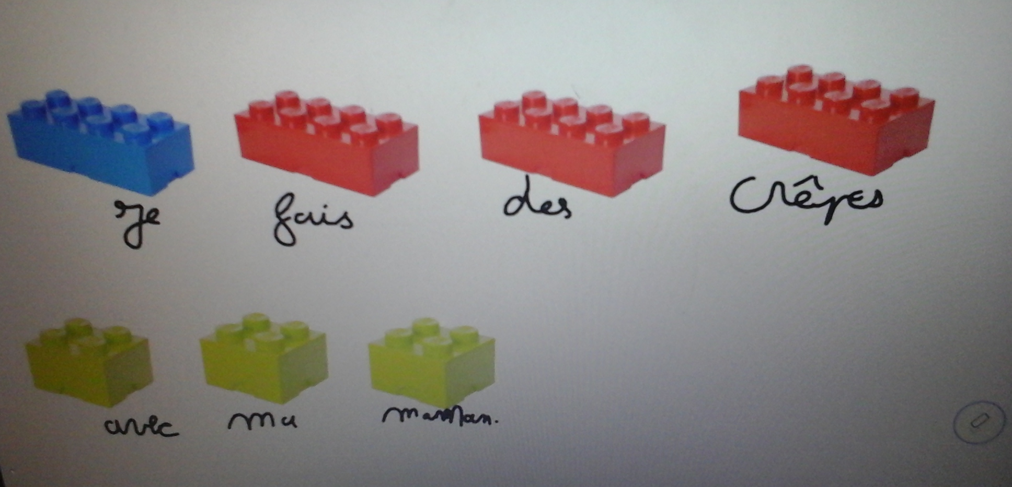
GRAMMAR WITH LEGOS

Slide 21
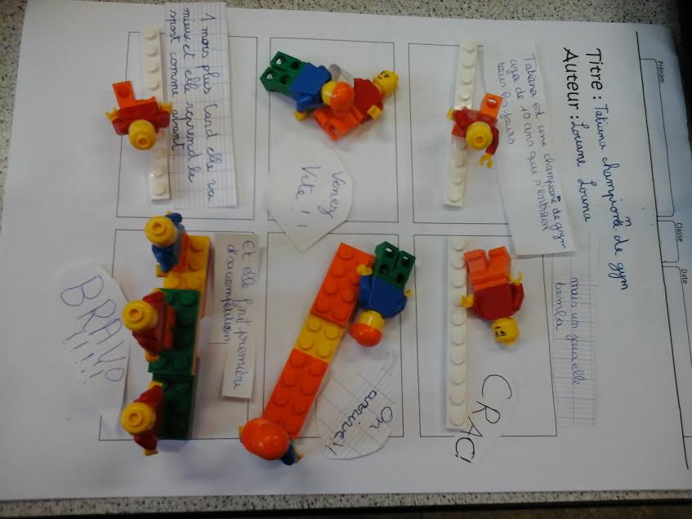
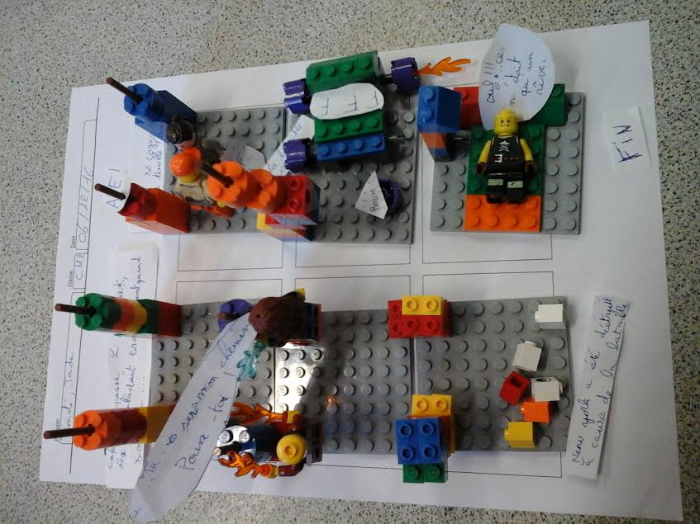
WRITING WITH LEGOS

Slide 22
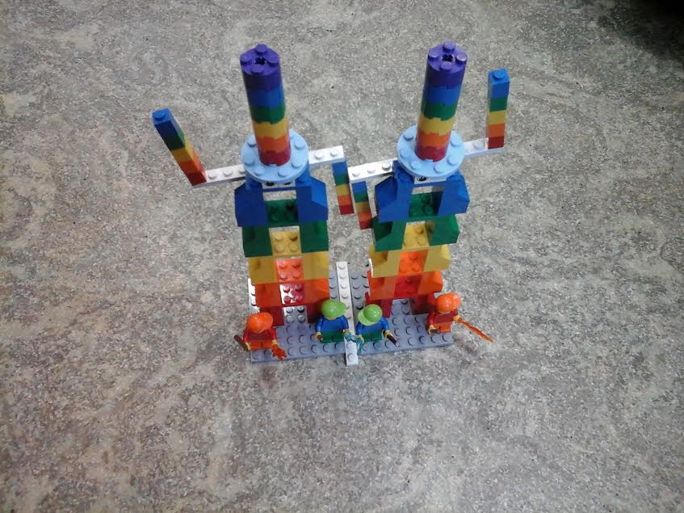
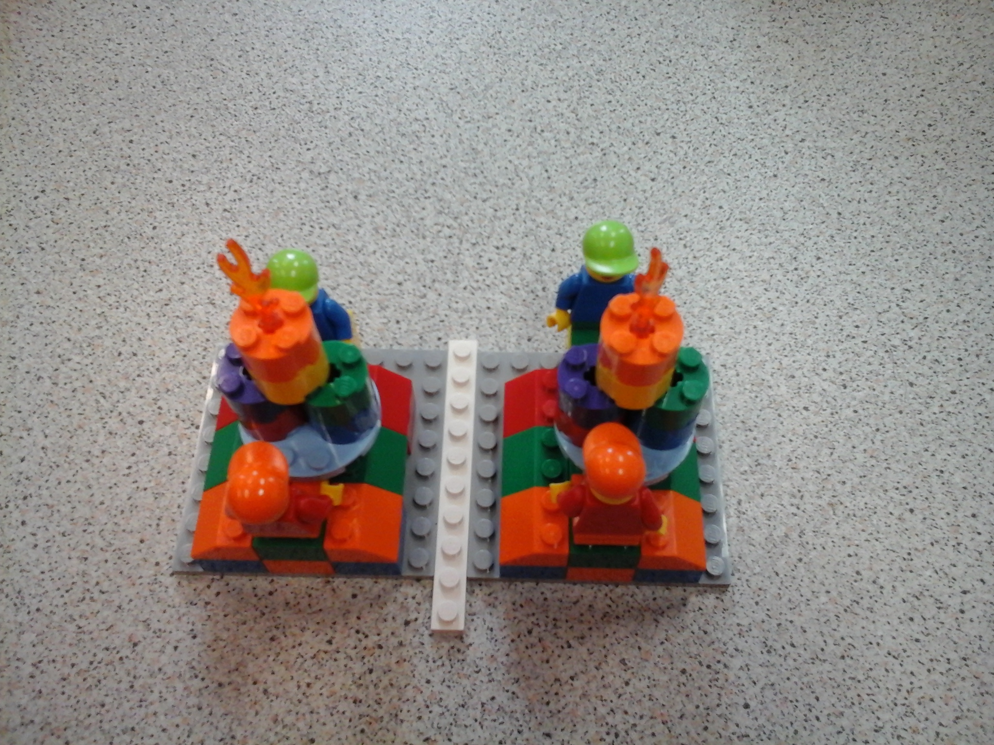
MATHS WITH LEGOS

Slide 23
3.WORKING WITH PLAYMOBIL
the first year of our project we worked mainly with playmos.
for description , colours and jobs and to mime some situations.
but quickly, we realized that legos offered much more possibilities and pupils prefered creating, inventing and building with legos.
but, of course, everytime we worked with playmos we were sûre that it was a great success ( when we discovered the vocabulary of the house they really enjoyed speaking of the different rooms in the playmobil’ s house)
each time we used playmos , it was the same that we did with legos, in small groups of 4 or 5 children.

Slide 24
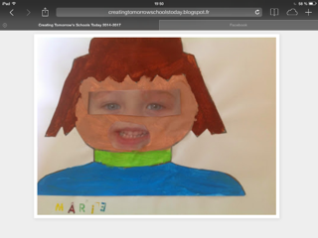
ARTCRAFTS

Slide 25
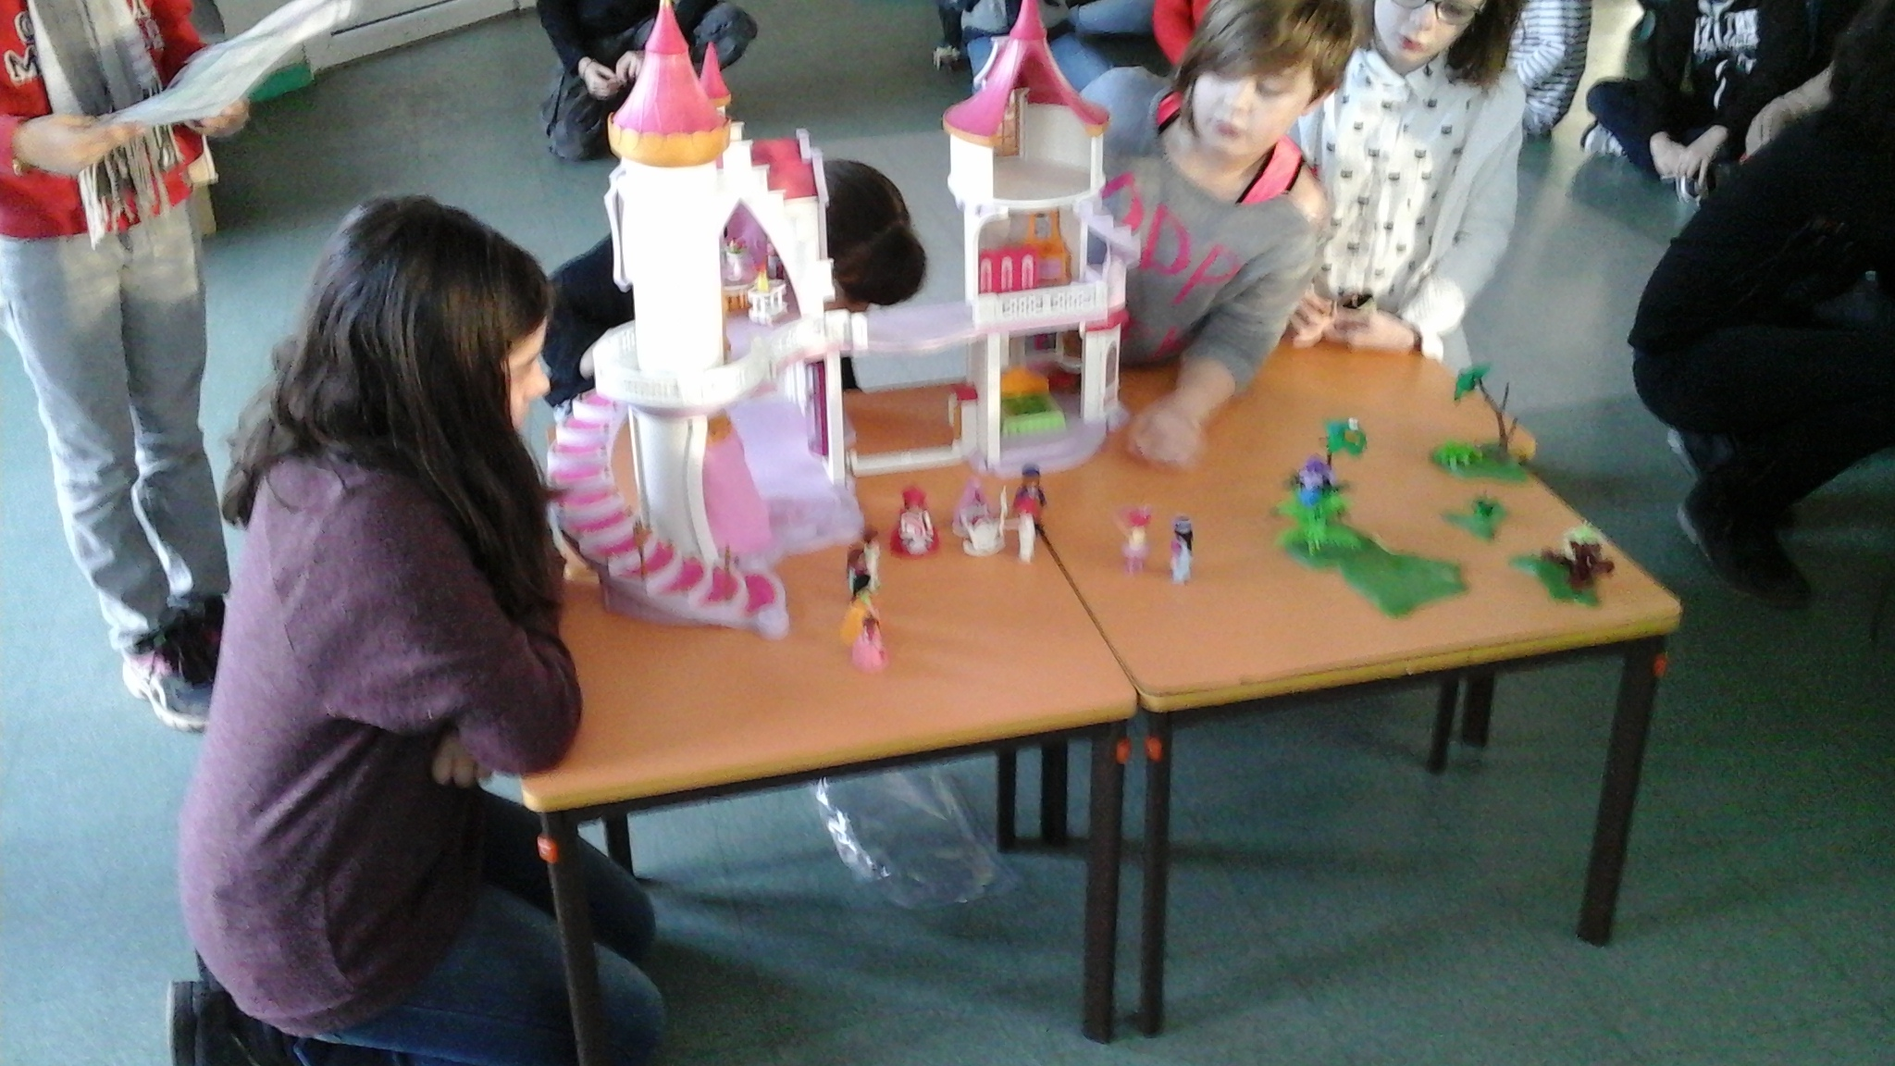
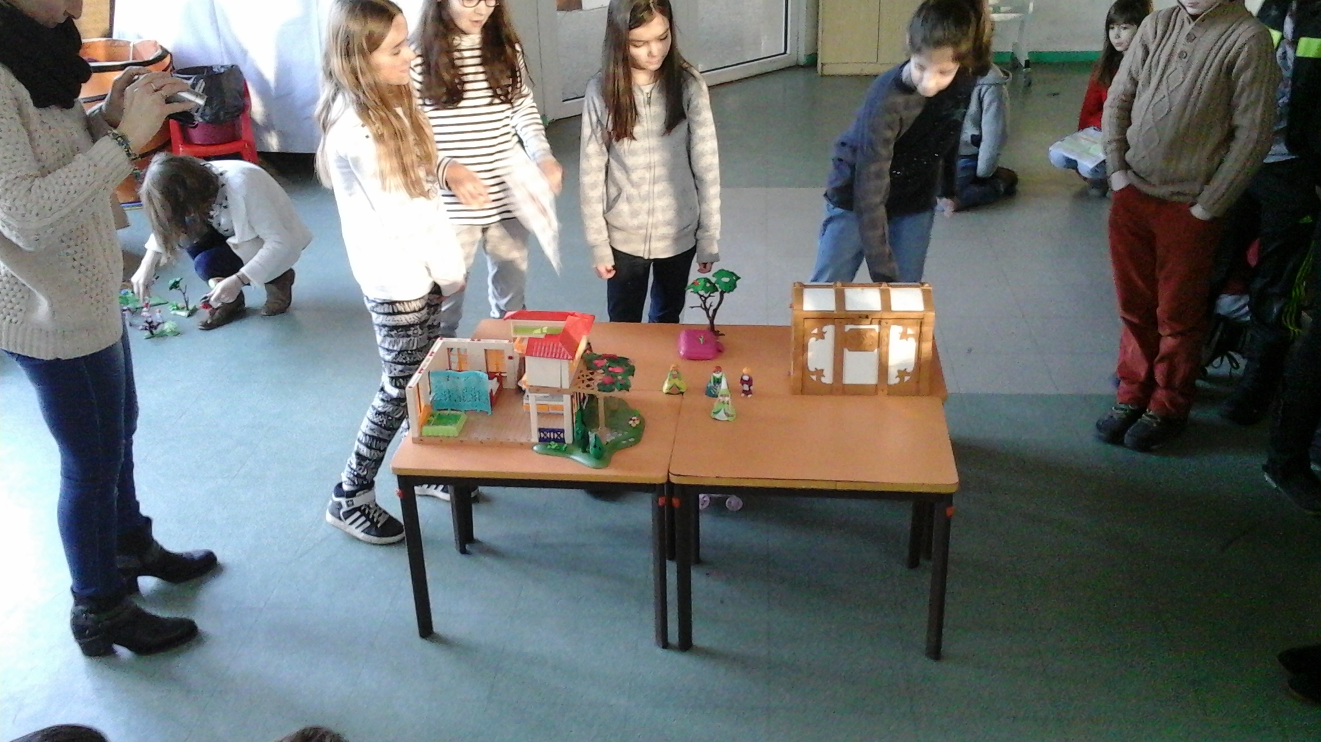
TALES WITH PLAYMO

Slide 26
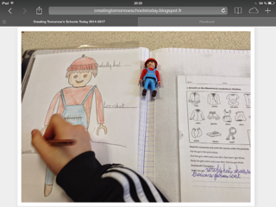
DESCRIPTION

Slide 27
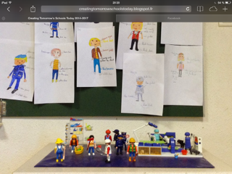
DRAWS ON JOBS

Slide 28
4.WORKING WITH SCHLEICH
Except in nursery school, we did not use schleich .
perhaps because we thought that in primary school , pupils are a bit too old to play with them.

Slide 29
5. CHILDREN’S LITERATURE
The first year of the project , children’s literature was linked with a common project of all different classes of our school named Expoesie.
The main idea was to mix youth literature and artcrafts. it was a great success and our works were hung in an open space in Clermont Ferrand.

Slide 30
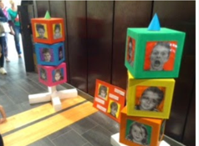
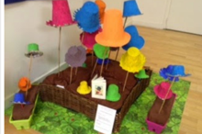
EXPOESIE

Slide 31
The second year , we called it the « fairy tale day » . All the teachers exchanged their classes and went in another classroom to read stories for other pupils . They enjoyed changing teachers for one day.

Slide 32
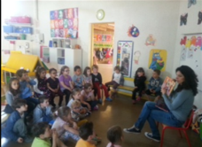
TALES

Slide 33
This year , our common project was Stickman .We worked on it just before Christmas . Nursery school and 3 classes participated (from 3 to 8 years old ) . The youngest had to describe Stickman’ s family through draws or constructions made with legos. In primary , they had to read the book and stop at the middle of the story to imagine an end .They could learn all the vocabulary about feelings through all the adventures of stickman.
Before christmas holidays , all the children watched the film in English and even the youngest could recognize many words and expressions that they heard before ( beware of the dog ...of the swan...)
Actually, we are working on the Gruffalo and the Gruffalo’s child with the nursery school and 1st grade in primary school. With legos they have to recreate the story and the main characters before identifying them. Then, they have to explain to the others why they chose this part of the story. The very young pupils are fascinated by this story because the Gruffalo frightens them . They enjoy so much that we often sing the gruffalo’s song ( found on you tube ) .

Slide 34
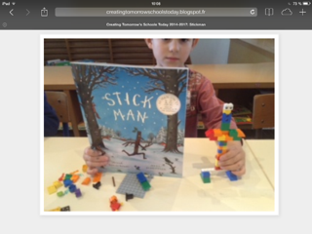
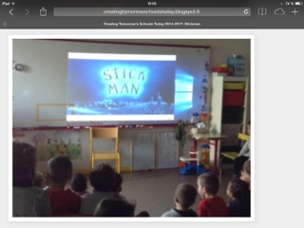
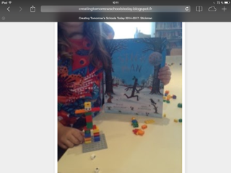
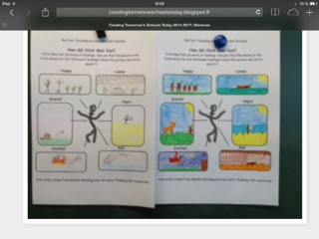
STICK MAN

Slide 35
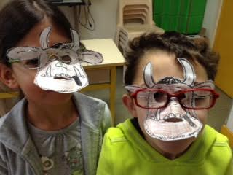
GRUFFALO

Slide 36
6.THE LITTLE PRINCE
For this project , only one class participated, the 5 th grade , the oldest of primary school. We cut the class into 2 parts , one studied the text in English and the other part in French. They also created the set and accessories for the 2 different planets .
We started to take pictures of the set while pupils animated the characters and the accessories.
Then, we recorded pupils performing their texts, and to finish , we put the recording on images.
To conclude with the litlle prince, we asked the children to imagine the 8 th planet of the story. They wrote a short text where they described their imaginary planet. They illustrated their text with draws, it was a very good work mixing writing exercice and artcrafts .

Slide 37
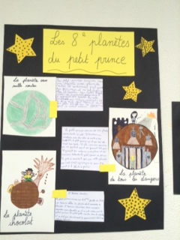
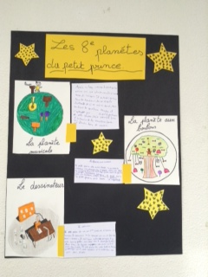

Slide 38
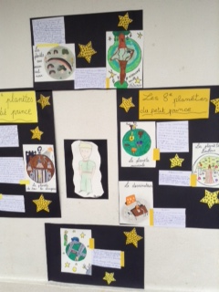

Slide 39
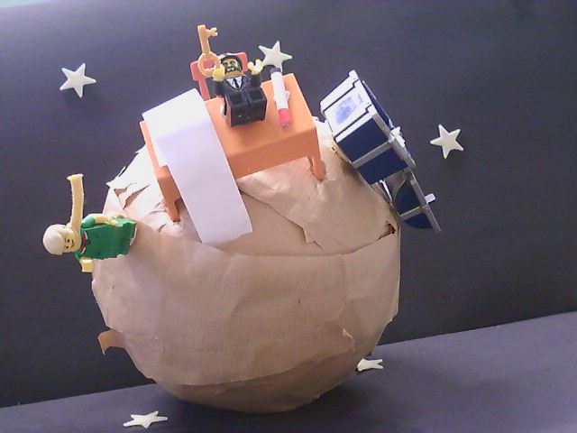

Slide 40
7. OUR BEST IDEAS
All the education team enjoyed working on common projects at the same time such as, European day, chocolate day, literature fair, Christmas...
Thanks to the blog, we could compare our works with our partners, share ideas, exchange methods like we did with the "cléments" .
Many of us did not hesitate to get inspired by an activity posted on the blog and turn it according to the needs of the learning in Maths , Science or Grammar or Arts.
Trough CTST, articles showed us different ways of teaching with Legos or Playmos
This blog is a kind of catalogue where you can pick out information so it is really useful .

Slide 41
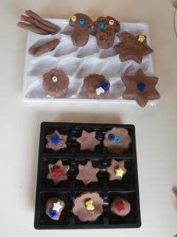
CHOCOLATE DAY

Slide 42
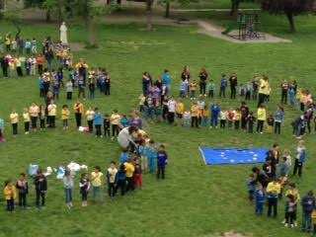
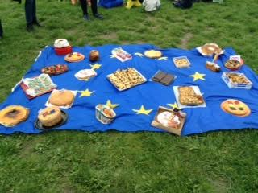
EUROPEAN DAY

Slide 43
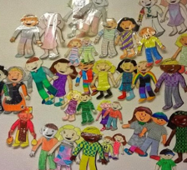
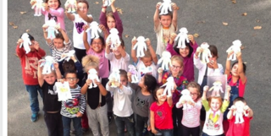
THE CLEMENTS

Slide 44
8. CHANGES IN SCHOOL DURING THE PROJECT
During those 3 years, we have conducted different common projects in team for Erasmus which offered the possibility to create more links with the teaching team ,and ,exchange ideas .
All of us enjoyed working with Playmos or Legos and, today, some teachers always start or end their lessons with Legos, it has become an essential tool in topics like Maths or French.
We realized that the use of Legos or Playmos make pupils more involved and offer them a better understanding and a bigger motivation.
we certainly improved our way of teaching, we innovated, collaborated with partners and shared many universal topics like tolerance and always in order to serve the interest of our pupils.

Slide 45
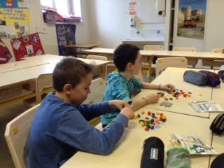
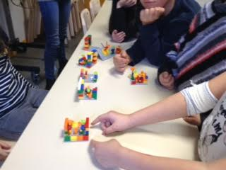
LEARNING AND PLAYING

Slide 46
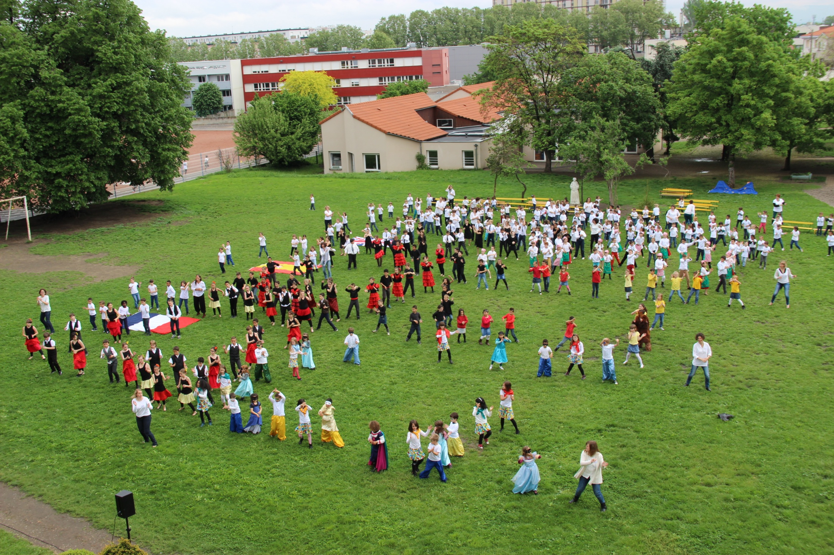
UNITED SCHOOL

Slide 47
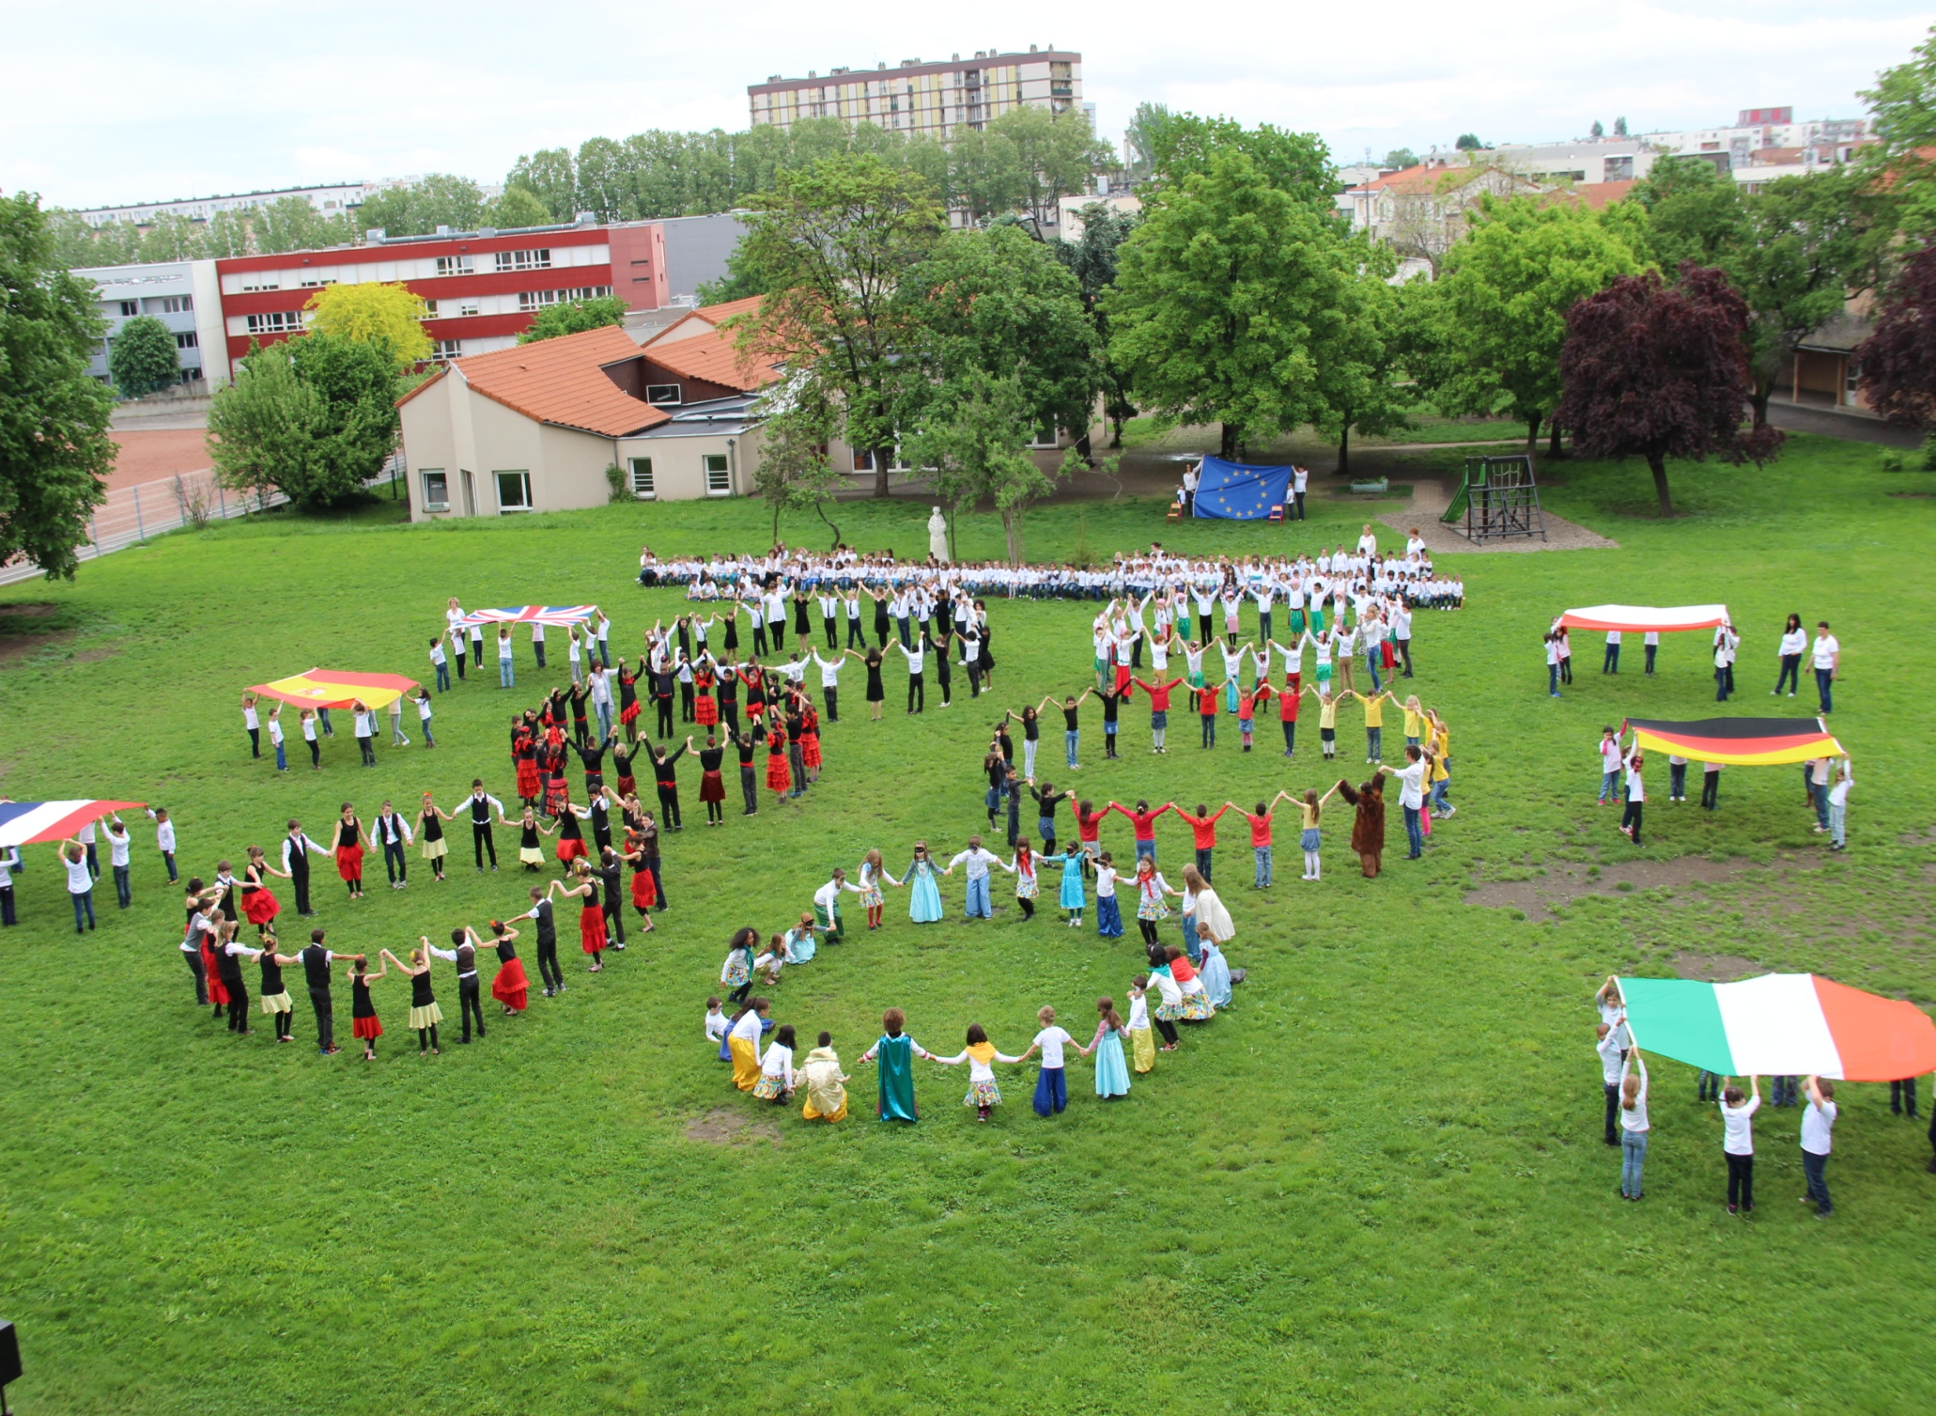
UNITED EUROPE

